Slide 1


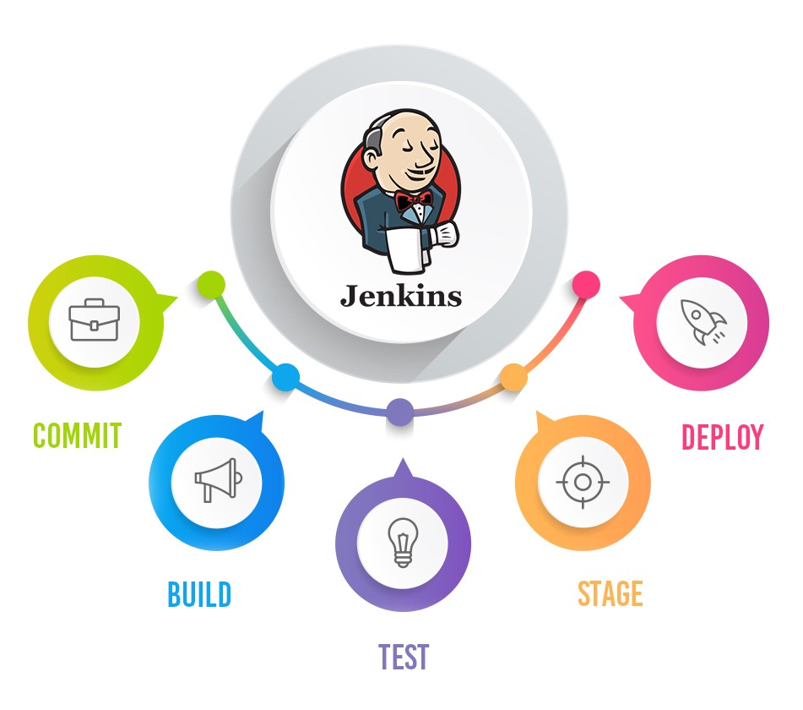
Jenkins Mastery for Software Tester
Pramod Dutta
Parameters in Jenkins

Slide 2

Why We need Parameters in Jenkins?
Make our Project more generic
You can change branch, env and other param while running
You can use logic based on env which command to run
E.g if Windows run this
Else run this

Slide 3
Executing Bash script in Jenkins
START "" notepad.exe D:\Project\notepad.bat

Slide 4
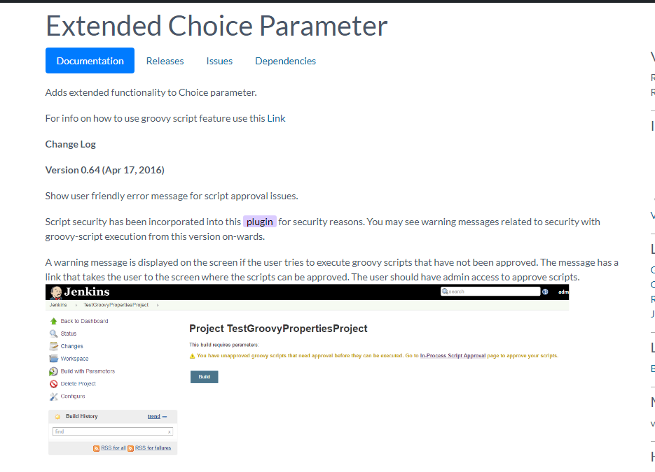
Extended Choice Parameter
Adds extended functionality to Choice parameter.

